Slide 1
WEEK 1 Introduction to Machine Learning

Slide 2
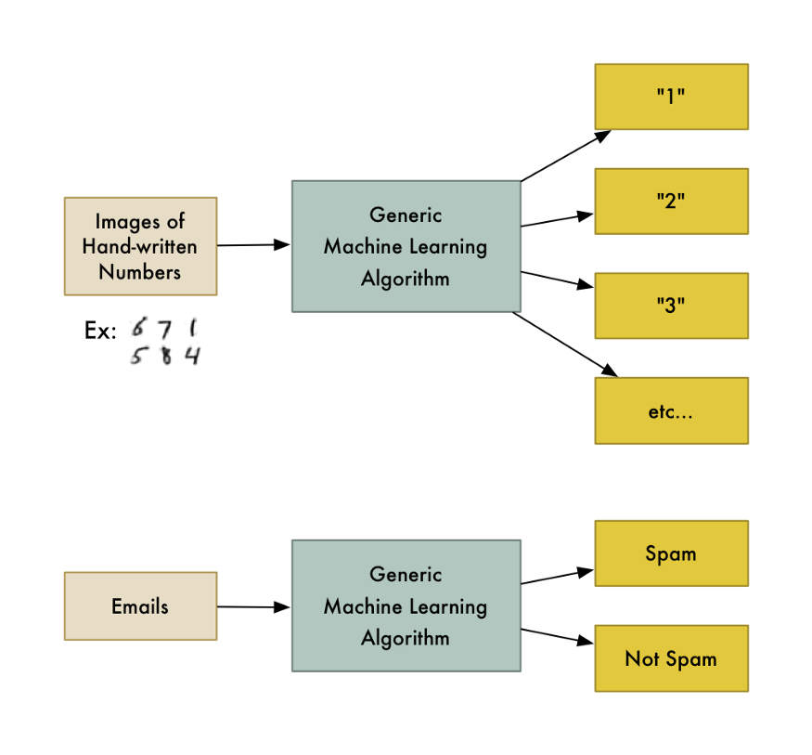
What is Machine Learning ?

Slide 3
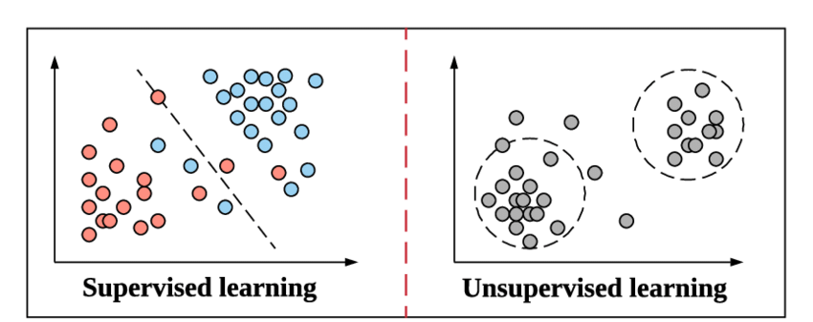
Machine Learning Types
Data with known classes or outputs
Classification or Regression
Data without classes
Clustering (Grouping Similar data points)

Slide 4
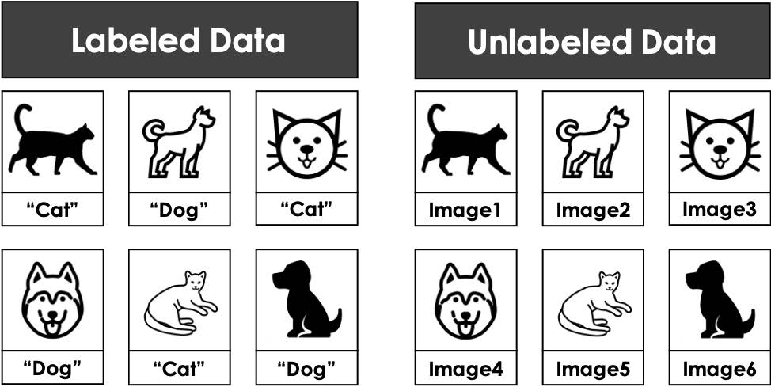
Datasets
For Supervised
Learning
For Unsupervised
Learning

Slide 5
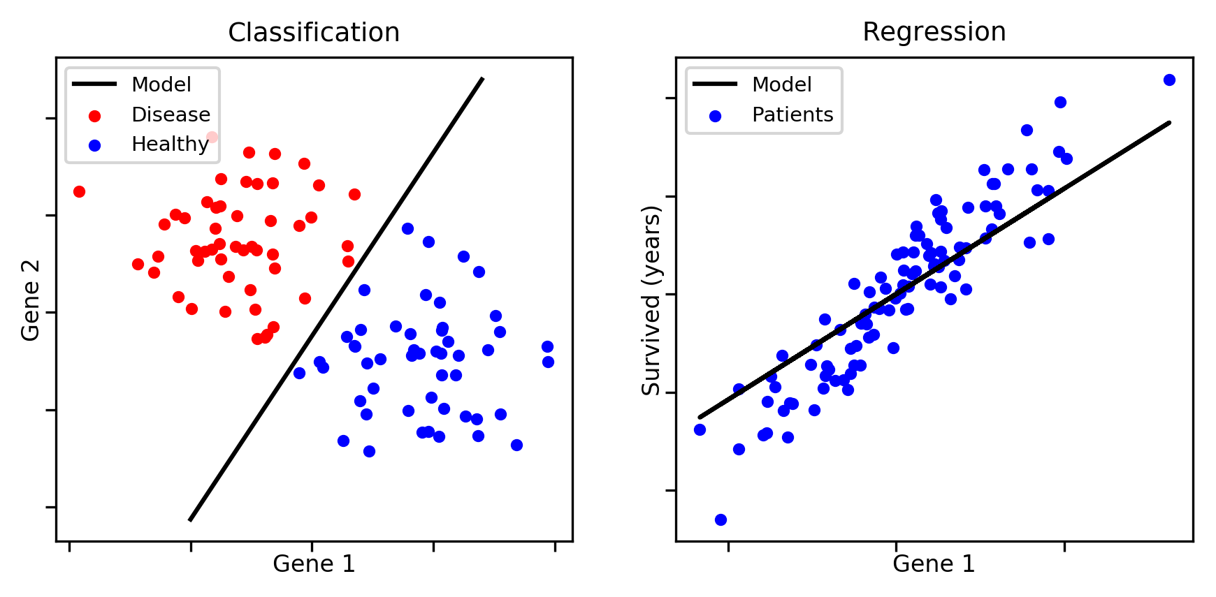
Classification vs Regression
Discrete Values (Classes)
Creates a boundary between classes
Continuous Values
Creates an estimation line to make predictions

Slide 6
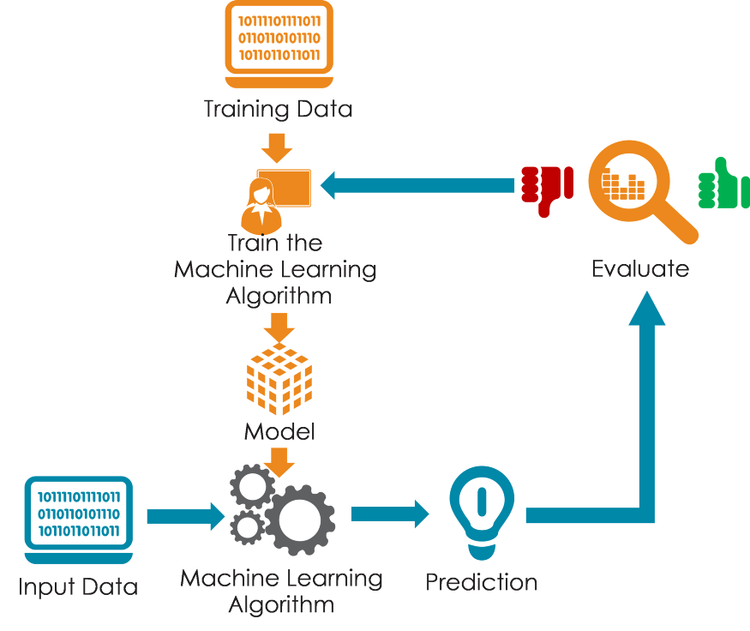
How Does It Work ?

Slide 7
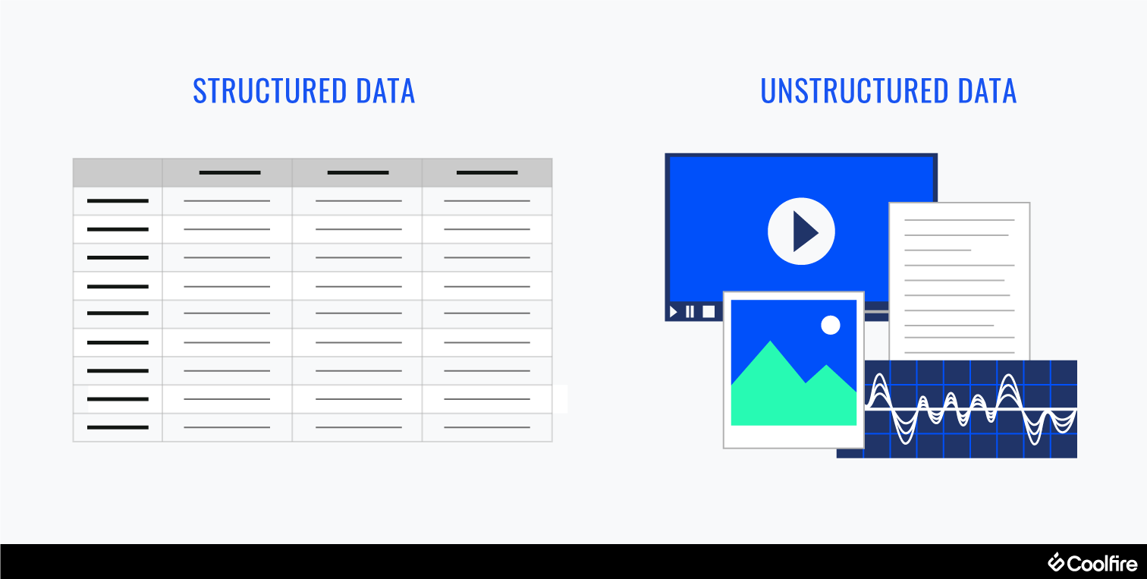
Data Types
Data with certain features
Easy to work with
Traditional Machine Learning Algorithms can handle it
Data without certain features
Not easy to work with
Mostly Deep Learning is used

Slide 8
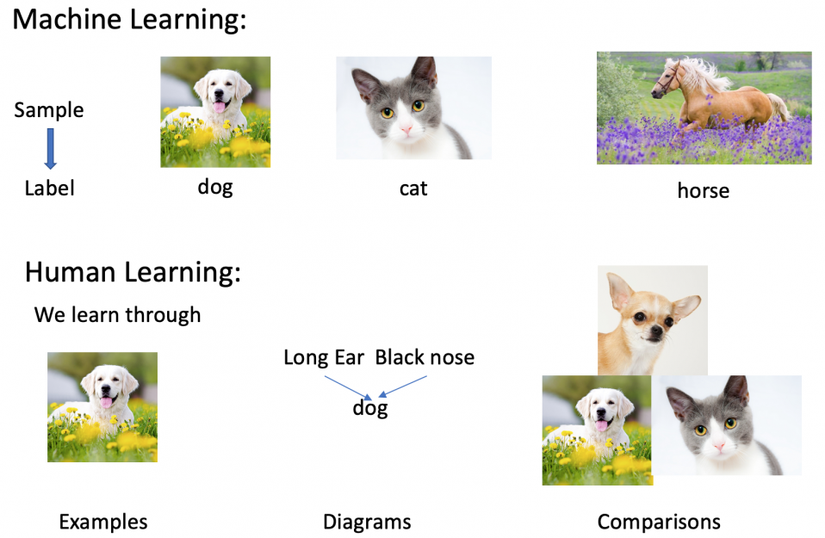
How Does a Machine Learn ?

Slide 9
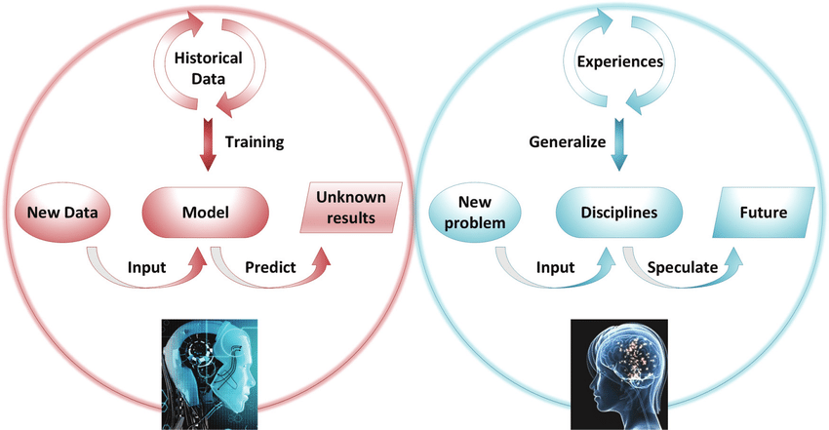
Machine and Human Learning

Slide 10
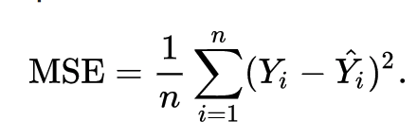
Minimizing Error
Prediction = F(Input Data)
COST =
True Label
Predicted Label

Slide 11
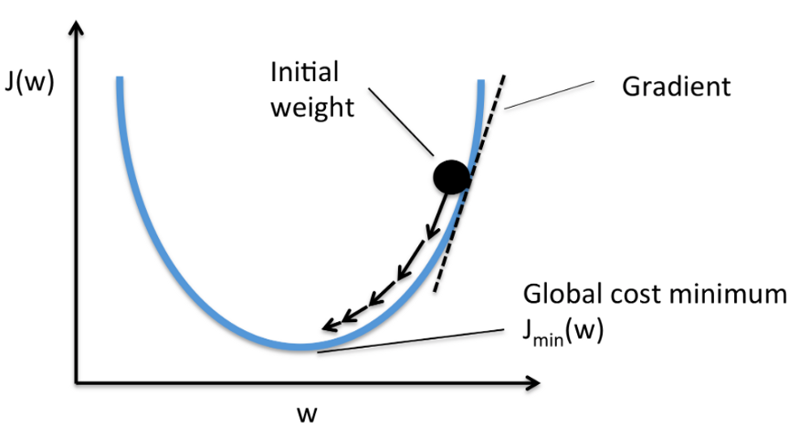
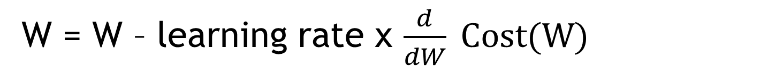
Gradient Descent
W = W – learning rate x $\frac{d}{dW} Cost(W)$

Slide 12
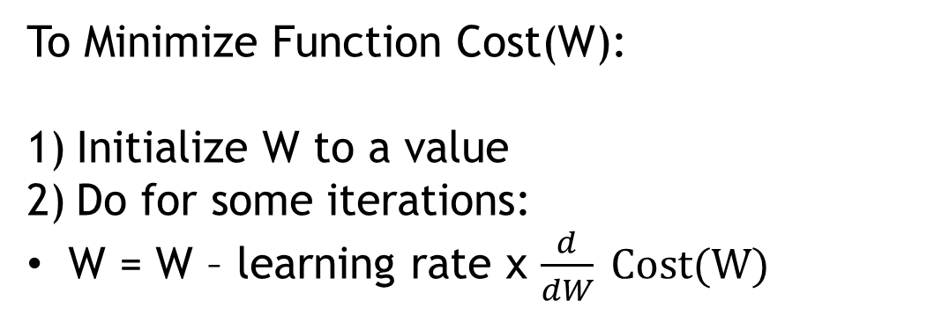
Gradient Descent
To Minimize Function Cost(W):
Initialize W to a value
Do for some iterations:
W = W – learning rate x $\frac{d}{dW} Cost(W)$

Slide 13
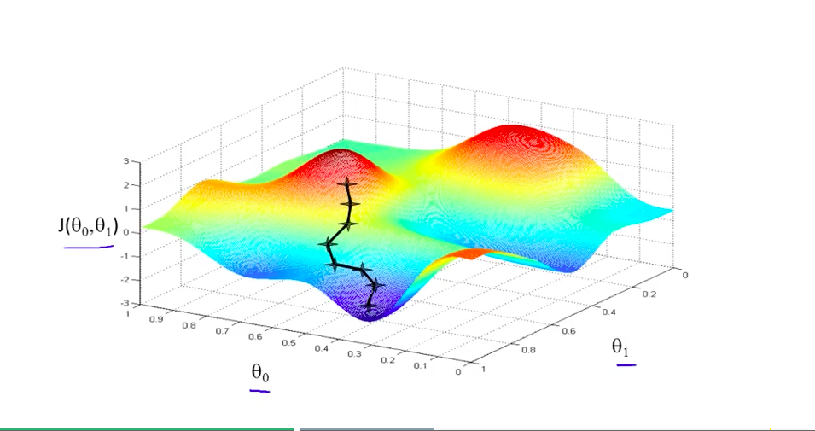
Gradient Descent
Y = θ1.X + θ0

Slide 14
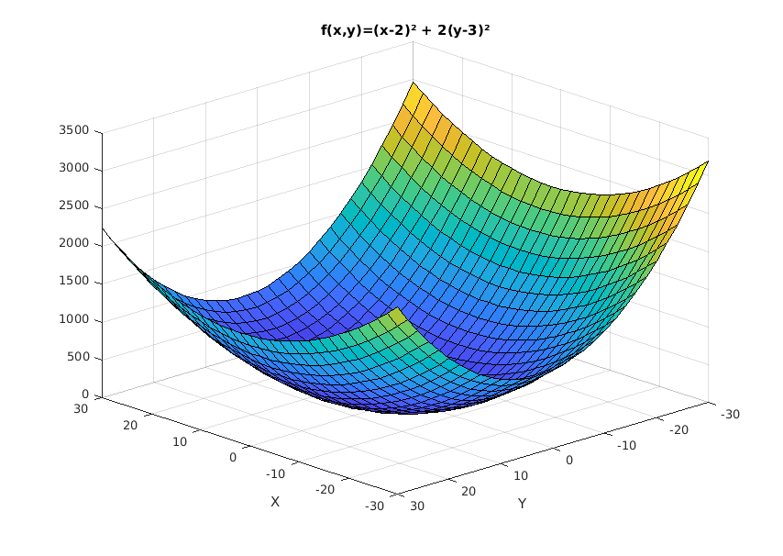
Gradient Descent

